Slide 1
Architecture Characteristics Worksheet
System/Project:
실리콘 샌드위치 온라인 주문 시스템
Domain:
전자상거래
Architect/Team:
노규남
Date:
2023-10-02
Candidate Architecture Characteristics
Top 3
Driving Characteristics
Implicit Characteristics
performance
data integrity
deployability
performance
feasibility (cost/time)
responsiveness
data consistency
testability
data integrity
security
availability
adaptability
abstraction
data consistency
maintainability
fault tolerance
extensibility
workflow
feasibility (cost/time)
observability
scalability
interoperability
configurability
security
elasticity
concurrency
recoverability
adaptability
Others Considered
scalability
others:
Instructions
Identify no more than 7 driving characteristics.
Pick the top 3 characteristics (in any order).
Implicit characteristics can become driving characteristics if they are critical concerns.
Add additional characteristics identified that weren’t deemed as important as the list of 7 to the Others Considered list.
a
denotes characteristics that are related; some systems only need one of these, other systems may need both
b
Last updated August 30, 2023
Created by Mark Richards, DeveloperToArchitect.com

Slide 2
Architecture Characteristics Worksheet
performance
adaptability
The amount of time it takes for the system to process a business request
The ease in which a system can adapt to changes in environment and functionality
responsiveness
concurrency
The amount of time it takes to get a response to the user
The ability of the system to process simultaneous requests, in most cases in the same order in which they were received; implied when scalability and elasticity are supported
availability
The amount of uptime of a system; usually measured in 9's (e.g., 99.9%)
interoperability
The ability of the system to interface and interact with other systems to complete a business request
fault tolerance
When fatal errors occur, other parts of the system continue to function
extensibility
scalability
The ease in which a system can be extended with additional features and functionality
A function of system capacity and growth over time; as the number of users or requests increase in the system, responsiveness, performance, and error rates remain constant
deployability
The amount of ceremony involved with releasing the software, the frequency in which releases occur, and the overall risk of deployment
elasticity
The system is able to expend and respond quickly to unexpected or anticipated extreme loads (e.g., going from 20 to 250,000 users instantly)
testability
The ease of and completeness of testing
data integrity
abstraction
The data across the system is correct and there is no data loss in the system
The level at which parts of the system are isolated from other parts of the system (both internal and external system interactions)
data consistency
workflow
The data across the system is in sync and consistent across databases and tables
The ability of the system to manage complex workflows that require multiple parts (services) of the system to complete a business request
Last updated August 30, 2023
Created by Mark Richards, DeveloperToArchitect.com

Slide 3
Architecture Characteristics Worksheet
configurability
The ability of the system to support multiple configurations, as well as support custom on-demand configurations and configuration updates
recoverability
The ability of the system to start where it left off in the event of a system crash
feasibility (implicit)
Taking into account timeframes, budgets, and developer skills when making architectural choices; tight timeframes and budgets make this a driving architectural characteristic
security (implicit)
The ability of the system to restrict access to sensitive information or functionality
maintainability (implicit)
The level of effort required to locate and apply changes to the system
observability (implicit)
The ability of a system or a service to make available and stream metrics such as overall health, uptime, response times, performance, etc.
Last updated August 30, 2023
Created by Mark Richards, DeveloperToArchitect.com

Slide 4

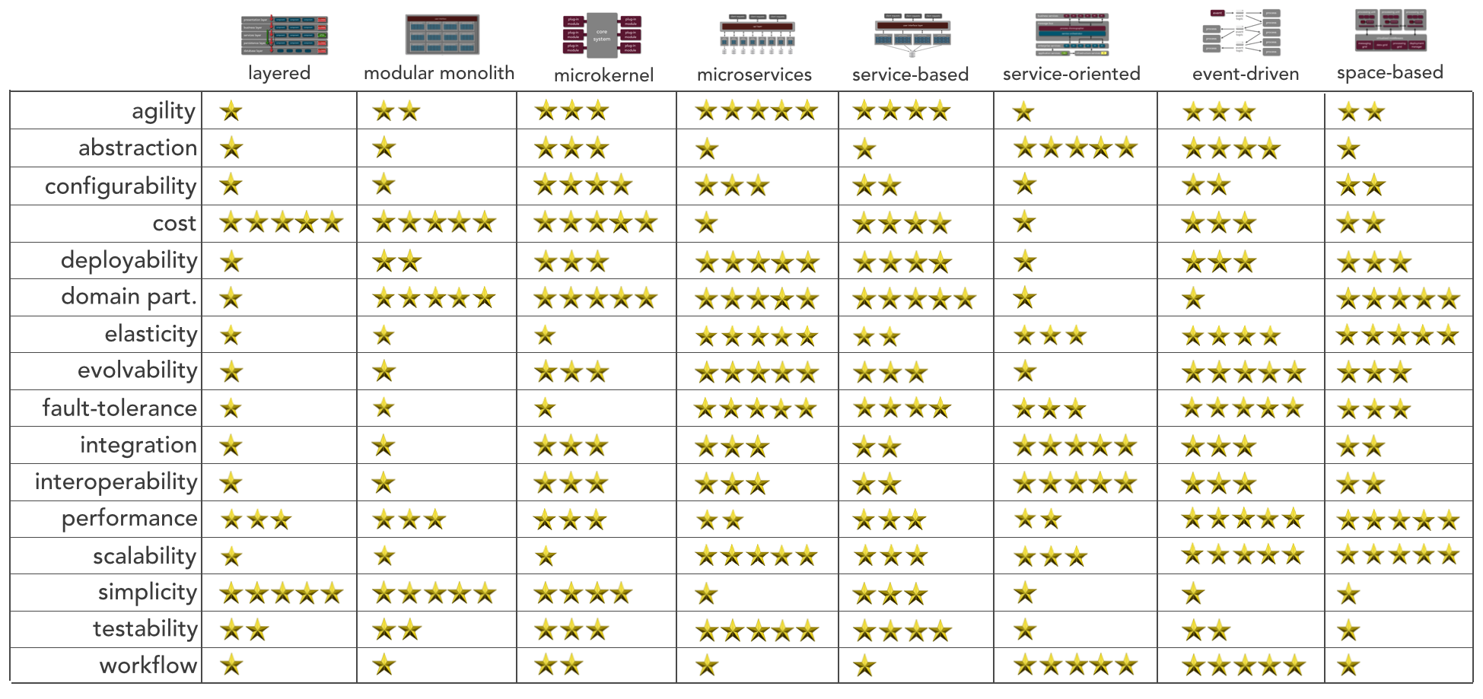
Architecture Styles Worksheet
System/Project:
Architect/Team:
Date:
Selected Architecture(s):
Created by Mark Richards, DeveloperToArchitect.com

